Slide 1
PGST Propane
Disaggregation
Bottom-Up Methodology — ERA5 · Regression · Equipment Modeling
Port Gamble S'Klallam Tribe | Energy Analysis

Slide 2

ERA5 Reanalysis Dataset
Temperature Data Source & Handling
What is ERA5?
Step 1 — Bilinear Interpolation
Grid-cell → site-point
ERA5 native 0.25° cells (~28 km) don't match the site exactly.
Interpolation done with bilinear weighting on the four surrounding cells.
Site: lat 47.852°, lon 237.431° (ERA5 0–360° convention).
ERA5 is ECMWF's fifth-generation atmospheric reanalysis — a global hourly gridded climate dataset that blends historical observations with a physics-based model. Grid resolution: 0.25° (~28 km) Variable used: 2 m air temperature (t2m) Record period: 2015–2026 (hourly) Format: GRIB2 (ERA5 download) Parser: cfgrib / xarray
Step 2 — Unit Conversion
Kelvin → °F: (K − 273.15) × 9/5 + 32
Step 3 — Daily Summary
Collected T_{avg}, T_{min}, and T_{max} for each day
Outputs: 2015-2026 Hourly and Daily Temperature CSVs

Slide 3


Delivery Data Cleaning
Propane Transaction Records — Ferrell Gas 2005–2025
Raw transaction records include deliveries, credits, and returns. Two cleaning rules are applied before the delivery file is used downstream.
Assumption 1 — Remove Return Deliveries
Assumption 2 — Minimum Delivery Size
Negative-gallon transactions represent returned/credited deliveries. Rule: For each negative entry, search for a positive entry with exactly matching gallons within ±30 days. Drop both. Rationale: These are accounting corrections, not actual fuel deliveries, and would double-count if retained.
Small deliveries likely represent alternate propane tank fills under the same account. Rule: Drop all deliveries under 200 gallons. Rationale: Routine deliveries serving the campus buildings are always bulk fills. Sub-200 gal records are not representative of steady-state consumption.
Output: Propane Deliveries 2005–2025.csv — used directly by regression (Notebook 3) and the disaggregation model (Notebook 4). Monthly aggregation logic is intentionally excluded from downstream use.

Slide 4
Delivery-Window Regression
Fitting Propane Use vs. Temperature
Building Delivery Windows
Key Parameters & Outputs
Each delivery is the end of a consumption window beginning
at the prior delivery date. Window length = days between
deliveries. Gallons ÷ days = gal/day for that window.
Interval-average temperature is computed from daily ERA5 data.
Window
2023–2025
Balance Point Tb
60 °F
Piecewise Linear Model
Design Min
20 °F
Below Tb (60°F): gal/day = m × T + b [heating regime]
Above Tb (60°F): gal/day = baseline_gpd [base loads only]
Baseline is the mean of all windows with T ≥ Tb.
Tb sweep: 50–71°F tested; 60°F selected.
Outliers Removed
2
Outputs
m (slope), b (intercept), baseline_gpd
Outlier Removal
Metrics
R²_heat, R²_baseline
After first fit, the 2 windows with largest absolute residual
are dropped. Model is refit on the cleaned set.
A4

Slide 5
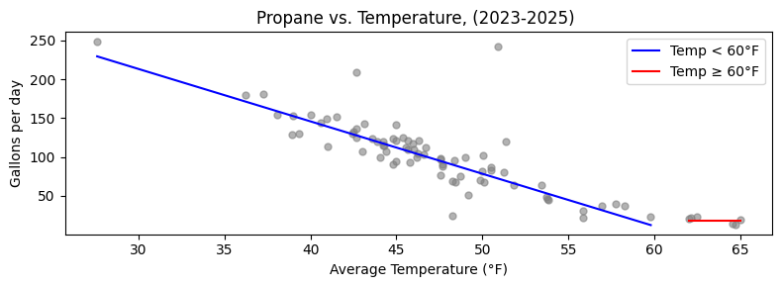

m=-6.742649, b=415.5719, baseline=18.6820 (gal/day)
R² = 0.842

Slide 6
Linear Duty Cycle Method
Translating Outdoor Temperature → Hourly Propane Demand
Duty Cycle Formula
Duty Cycle at Key Temperatures
DC = (T_{b} − T_{outdoor}) / (T_{b} − T_{design_min})
Tb = 60°F (balance point)
T_{design_min} = 20°F (design winter minimum)
DC is clipped to [0.0, 1.0].
T = 20°F (design min)
DC = 1.0 → Full rated input
T = 40°F (cold day)
DC = 0.5 → Half rated input
Engineering Storytelling
T = 60°F (balance pt)
DC = 0.0 → No heating needed
The design minimum of 20°F reflects equipment sizing: the heating systems are designed to maintain comfortable indoor temperatures down to this outdoor threshold. Over the 2023–2025 period, temperatures fell below 20°F on only one day (1/13/2024), reaching a minimum of 16.8°F.
T = 75°F (summer)
DC = 0.0 → Clipped to zero
Hourly BTU/hr = Rated Input (BTU/hr) × Duty Cycle × Scale Factor
Scale factor calibrates unscaled model output to match top-down delivery-window targets.

Slide 7
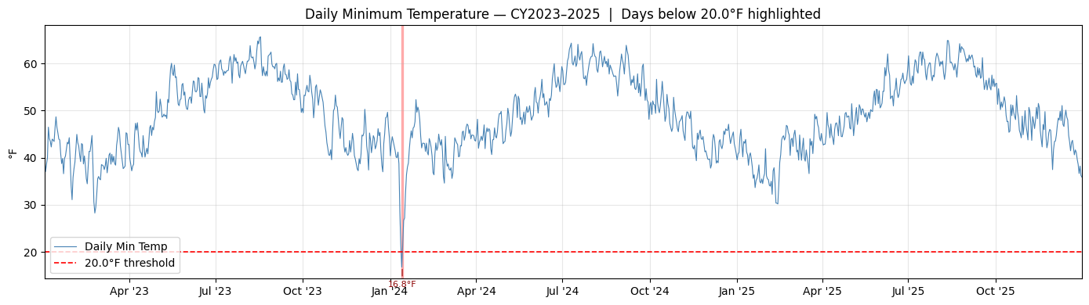

Slide 8
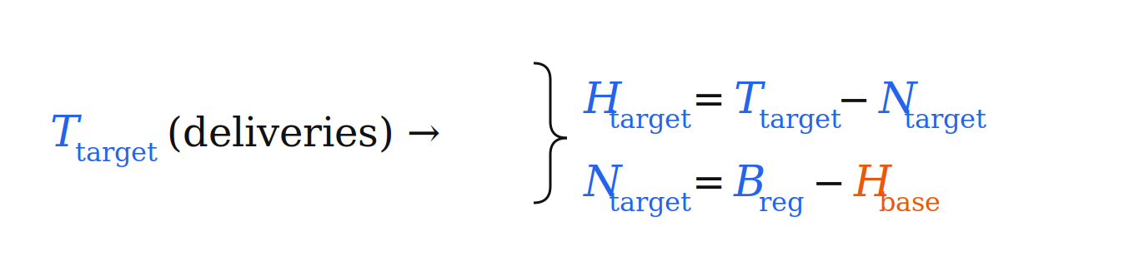
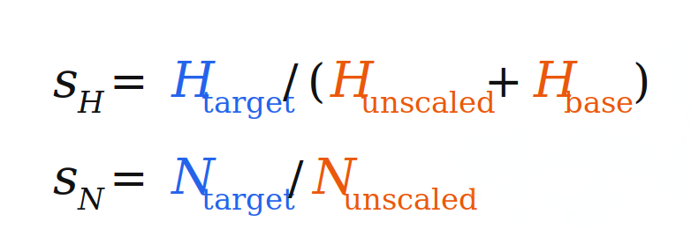
Annual Scaling to Top-Down Targets
First, use regression/heating baseline to split total propane into heating and non-heating
Heating Scale Factor
Regression baseline B_{reg} accounts for all non-weather sensitive use
H_{base} is an assumed heating baseline from the boiler that is non-weather sensitive
Scale factors: (Top-down regression divided by bottom-up accounting)
Year | Heating Scale | Non-Heating Scale
2023 | 1.2683 | 1.0793
2024 | 1.1769 | 1.0434
2025 | 1.2254 | 1.0636
Scale factors near 1.0 indicate a well-fitted bottom-up model.

Slide 9
Rated-Capacity Cap & Redistribution
Preventing Physically Impossible Load Exceedances
After scaling, individual hourly loads may exceed a unit's rated input capacity. Excess energy is capped and redistributed within the same unit across hours where headroom exists.
Step 1 — Cap at Rated Input
Step 2 — Redistribute Excess
1) Clip any hour that exceeds rated_input_btu_hr back down to the nameplate max
2) Tally up the total excess Btu that got removed
The excess Btu removed by the cap are spread back across all hours of that unit, proportional to how much headroom each hour has below the nameplate max.
In practice this can bleed a small amount of load into low-demand hours (like summer), since those hours have the most headroom.
Example
Before (unclipped)
After (clipped + redistributed)
Hour 1: 420,000 BTU/hr ← exceeds 378,000 rated cap
Hour 2: 310,000 BTU/hr
Hour 3: 295,000 BTU/hr
→
Hour 1: 378,000 BTU/hr (clipped; 42,000 excess)
Hour 2: 310,000 + 24,500 = 334,500 BTU/hr
Hour 3: 295,000 + 17,500 = 312,500 BTU/hr

Slide 10
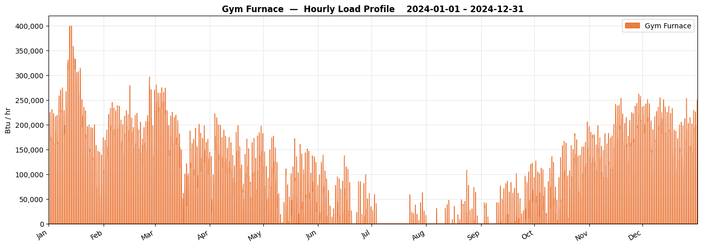

Rated: 400,000 BTU/hr input

Slide 11
Boiler — Primary Space Heating
HEATING
unit_1 · Heating Equipment
Scheduling
Equipment Specs
Model Parameters
Days: All 7 days
24/7 heating
Rated: 378,000 BTU/hr input
314,000 BTU/hr output (83.1% efficiency)
Thermostat-fighting override: boiler subject to hysteresis shutoff.
Baseline fighting load (+30% duty-cycle floor) applied to this unit only.
Engineering Story
The boiler is the dominant propane consumer. The 30% DC floor captures controls hysteresis (AC vs. boiler fighting) that persists even in mild weather.

Slide 12
Thermostat Fighting & Boiler Hysteresis
Operational Reality — Boiler Cycling by Facilities Staff
The Problem
State Machine Logic
During mild weather, the boiler and AC system fight each other — the boiler heats while AC cools. Facilities staff intervene manually, cycling the boiler off when it is locally too hot, and back on when it gets cold again.
BOILER ON
BOILER OFF
T > 60°F
for 12 hrs →
← T < 54°F
for 12 hrs
Hysteresis State Machine Parameters
Shutoff threshold: 60°F (BOILER_SHUTOFF_TEMP_F)
Restart threshold: 54°F (BOILER_RESTART_TEMP_F)
Shutoff delay: 12 hrs above threshold before staff acts
Restart delay: 12 hrs below threshold before restoration
State: boiler_on = True → False (shutoff) → True (restart)
When BOILER OFF:
• Weather-driven BTU/hr = 0
• Baseline-fighting load = 0
• Both go to zero — no propane
consumed during shutoff window

Slide 13
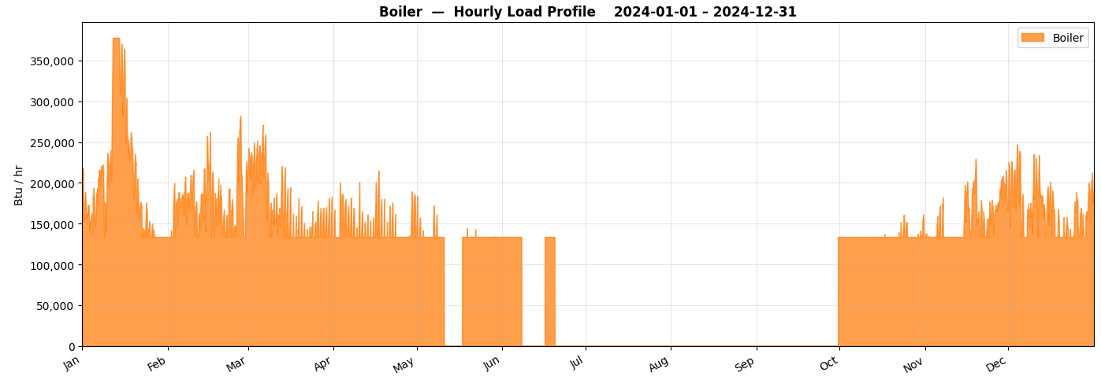

Slide 14
CFS Furnaces 1, 2 & 3
HEATING
unit_3 · Heating Equipment
Scheduling
Equipment Specs
Model Parameters
Days: All 7 days
24/7 heating
Rated: 222,000 BTU/hr input (3 × 74,000 BTU/hr)
177,600 BTU/hr output (80% efficiency)
Three identical 74,000 BTU/hr furnaces modeled as a single aggregate unit.
No thermostat-fighting override or baseline floor applied to this unit.
Engineering Story
CFS furnaces operates similarly to the boiler, but with no baseline floor as assumed to be no thermostat fighting.The three-unit aggregate simplifies the model without meaningful loss of accuracy.

Slide 15
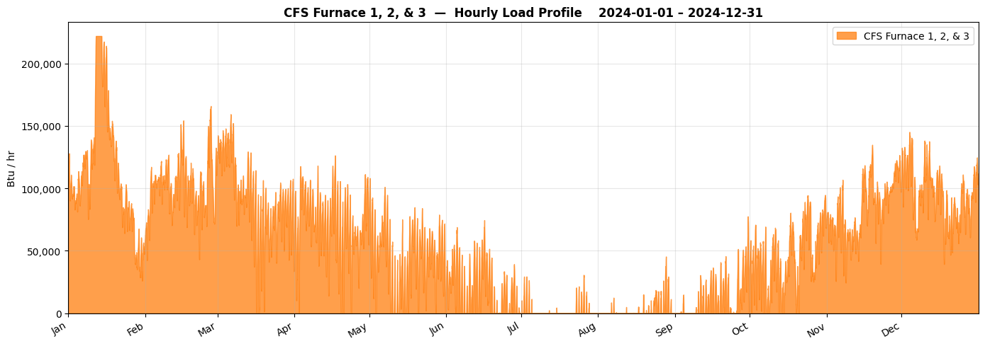

Slide 16
Gym Furnace — Cold-Soak Recovery
HEATING
unit_2 · Heating Equipment
Scheduling
Equipment Specs
Model Parameters
Days: All 7 days
3:00 PM – 9:00 PM (occupied only)
No setback heat (setback_temp_f = 0°F → DC = 0 when unoccupied)
Rated: 400,000 BTU/hr input
324,000 BTU/hr output (81% efficiency)
Cold-soak recovery: first 3 hours of each occupied block use 70°F balance point instead of 60°F.
No thermostat-fighting override or baseline floor applied to this unit.
Gym balance point is 70°F to represent cold-soak recovery
Cold-soak recovery period lasts 3 hours from first occupied hour each session.
Engineering Story
The gym sits unoccupied all morning; the building cools toward outdoor temperature. When staff arrive at 3 PM the furnace must overcome both the steady-state heat loss AND re-heat the thermal mass — modeled as a higher effective balance point during the first 3 hours of each occupied block.

Slide 17
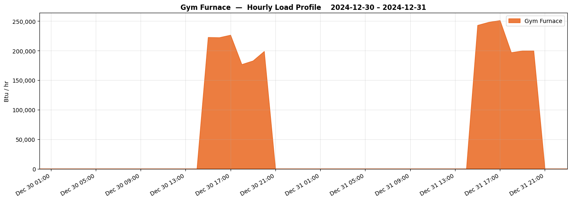

Slide 18
Elder Center Stove
NON-HEATING
Non-Heating Equipment
Scheduling
Equipment Specs
Model Parameters
Days: All 7 days
7:00 AM – 9:00 AM (breakfast prep)
11:00 AM – 1:00 PM (lunch service)
Imperial IR-6-RG24 Commercial Stove
Rated: 302,000 BTU/hr input
Utilization = 80% — high-throughput community kitchen.
Largest non-heating propane consumer by rated capacity.
Elder Center operates 7 days/week with full food service for breakfast and lunch.
80% utilization is consistent with observed community meal service volumes.
Engineering Story
The Elder Center serves hot meals 7 days a week, making it the only non-heating propane load that runs on weekends. Its 302,000 BTU/hr commercial range is the largest single non-heating appliance — the breakfast + lunch dual window structure captures the actual meal-service rhythm.

Slide 19
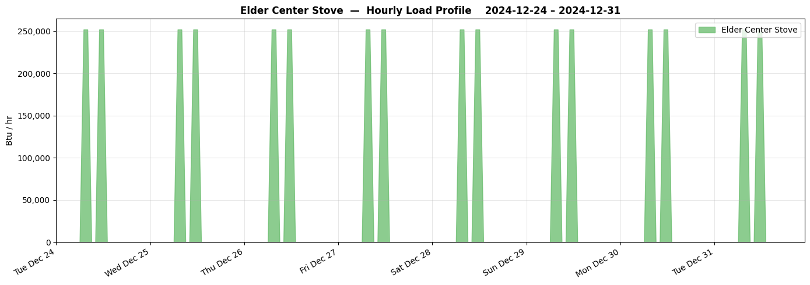

Slide 20
ECC Domestic Hot Water Heater
NON-HEATING
Non-Heating Equipment
Scheduling
Equipment Specs
Model Parameters
Days: Weekdays (Mon–Fri)
5 one-hour windows: 8–9 AM, 10–11 AM, 12–1 PM, 2–3 PM, 4–5 PM
Showering, cooking, dishwashing, etc.
Assumed: 75,000 BTU/hr input
Utilization = 100% — assumed full-fire during each window.
Load is temperature-independent; classified as non-heating.
Then scaled using non-heating scaling factor for each year
A3
A4
Engineering Story
Hot water demand is independent of outdoor temperature. The five one-hour windows were chosen to represent off and on peaks due to showering, cooking, and washing dishes, rather than a continuous burn.

Slide 21
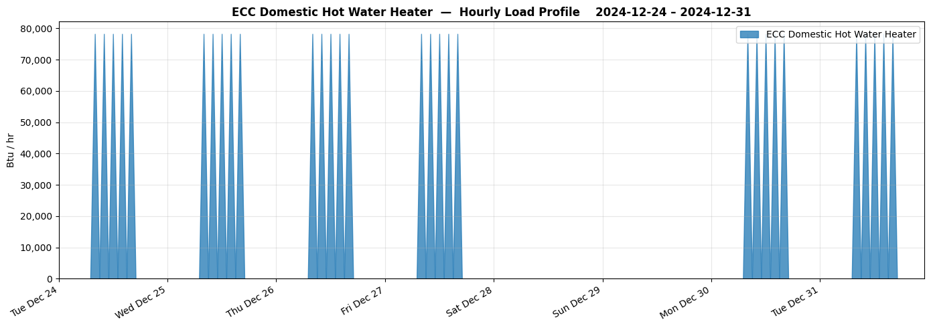

Slide 22
ECC Kitchen Stove
NON-HEATING
Non-Heating Equipment
Scheduling
Equipment Specs
Model Parameters
Days: Weekdays (Mon–Fri)
11:00 AM – 1:00 PM (lunch service, 2-hour window)
Assumed: 60,000 BTU/hr input
Utilization = 80% — not all burners on simultaneously during every lunch.
80% burner utilization during lunch service is a reasonable average for an institutional kitchen.
Engineering Story
The ECC stove operates primarily during the lunch service window. An 80% utilization factor accounts for the reality that not all burners are running simultaneously at every meal — typical of batch cooking for variable crowd sizes.

Slide 23
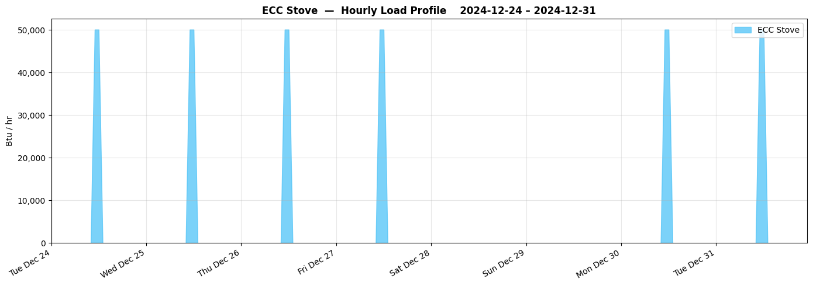

Slide 24
Admin Building Kitchen Stove
NON-HEATING
Non-Heating Equipment
Scheduling
Equipment Specs
Model Parameters
Days: Weekdays (Mon–Fri)
11:00 AM – 12:00 PM (one-hour window)
Assumed: 60,000 BTU/hr input
Utilization = 20% — lightly used; staff heating occasional meals.
Very small contribution to total propane budget.
20% utilization reflects a staff break-room stove used sporadically, not a full kitchen operation.
Engineering Story
The admin kitchen is a break-room-style kitchen, not a full food service operation. The 20% utilization factor captures occasional use — staff reheating lunches, occasional small cooking tasks — during a 1-hour daily window.

Slide 25
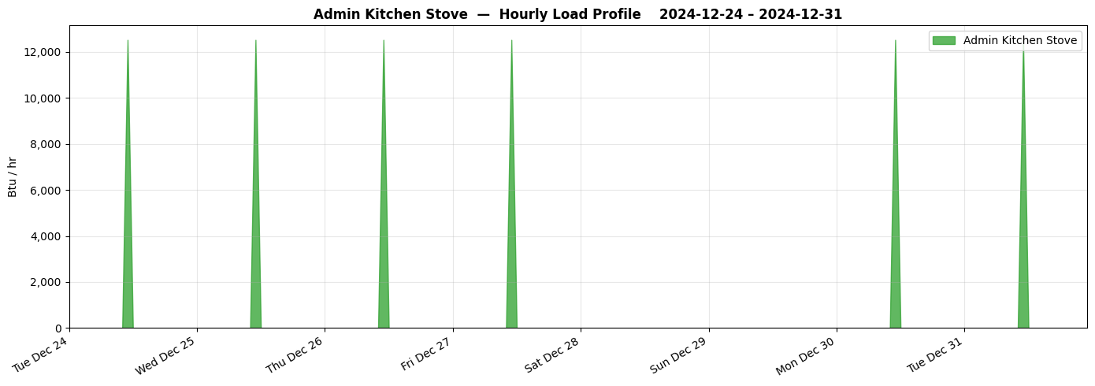

Slide 26
